Slide 1
Clustering Plotted Data by Image Segmentation
Tarek Naous , Srinjay Sarkar , Abubakar Abid , James Zou
409410003 李文翔 408410046 龔鈺閎

Slide 2
Outline
Introduction
Method
Core Algorithm
Optional processing
Experimental results
Notes:
Introduce the background of the research
E

Slide 3
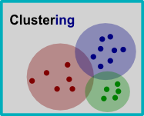
Introduction
Visual Clustering
A new clustering method inspired by how humans cluster data
Faster
&
K means, GMM, DBSCAN
Human intuition
&
Neural Networks used
Notes:
it is much faster than most existing clustering algorithms (making it suitable for very large datasets), it agrees strongly with human intuition.
The most commonly used clustering algorithms, such as K-means clustering [5], Gaussian mixture clustering, treat samples as points in Euclidean space, group together points based on distances
DBSCAN is a density-based clustering,
considers a group of points belonging to the same cluster if there are a certain number of points in the neighborhood of the selected point.
Since most of these algorithms, they calculate the distance, they scale poorly to large dataset

Slide 4
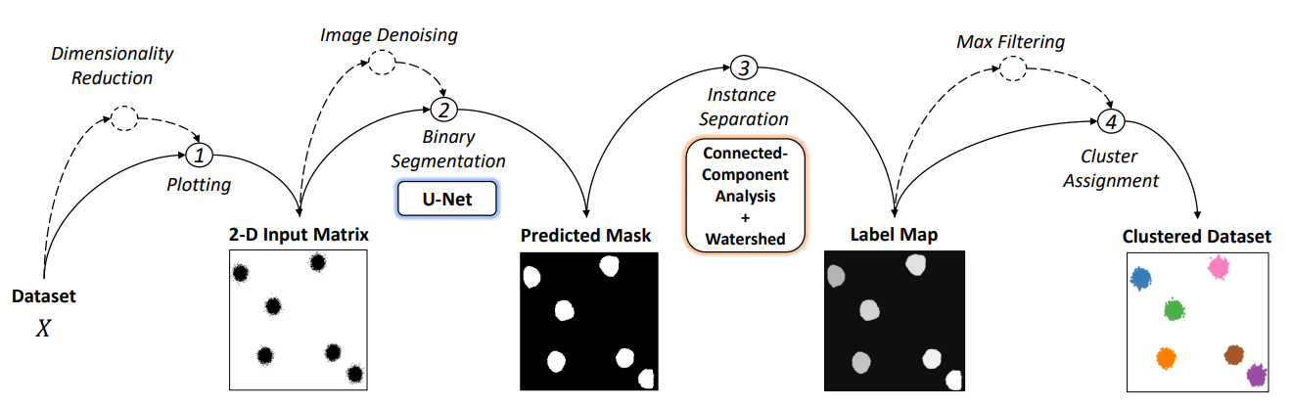
Method
Diagrammatic view of our Visual Clustering algorithm
Notes:
So that’s said we got a bunch of data called X dataset
And the output

Slide 5
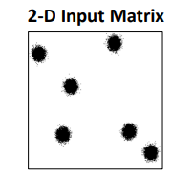
Core Algorithm
linearly shifting the values of both features to be 256*256
χ
Dataset
PCA (optional)

Slide 6
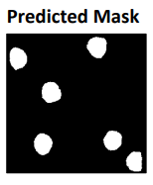
Core Algorithm
2. feed as an image input to the pre-trained binary segmentation model
Binary Segmentation
(U-Net)
Shows where cluster areas are located.
Notes:
Make a prediction about where is the data. Turn it into a binary mask.
But it does not indicate how many clusters

Slide 7
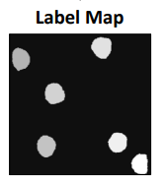
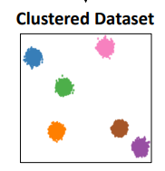
Core Algorithm
3. Separating the instances (or clusters) present in the binary mask.
Connected Component Analysis
+
Watershed transformation
Cluster Assignment
Notes:
To separate the instances (or clusters) present in the binary mask
This results in a label map where pixels belonging to the same cluster are assigned the same label value
The final step in our approach is cluster assignment, where we assign a cluster label to each sample in the dataset based on its location in the label map.

Slide 8
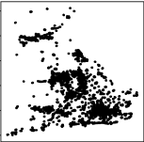
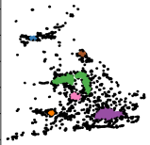
Optional Processing
Inseparable Clusters
Close to real-world datasets
Median filter
Filter out low-density areas.
Unassigned Points
Points fall in regions that are outside but near the cluster area
Ignored by binary segmentation model
Maximum filter
Increase the area of each cluster

Slide 9
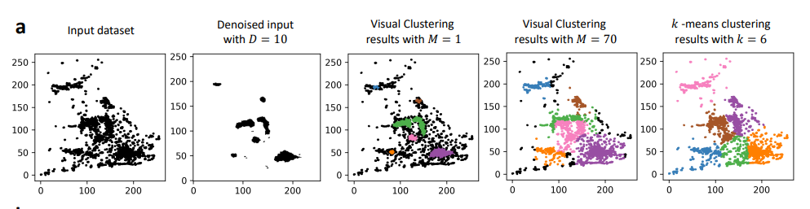
Optional Processing
Apply Median Filter and Max Filter to input data

Slide 10
Method
Diagrammatic view of our Visual Clustering algorithm

Slide 11
Experimental Results

Slide 12
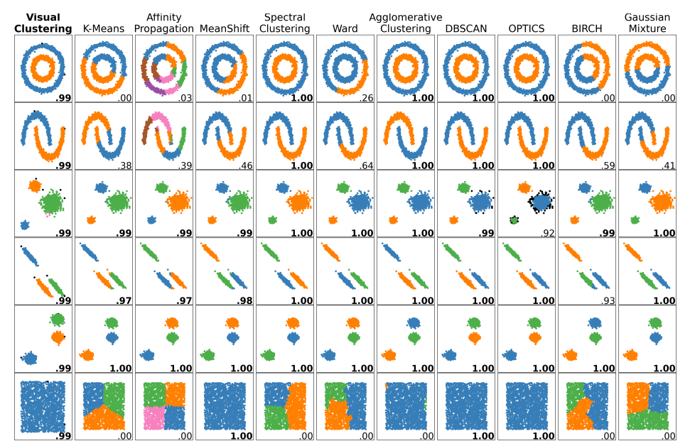

Slide 13
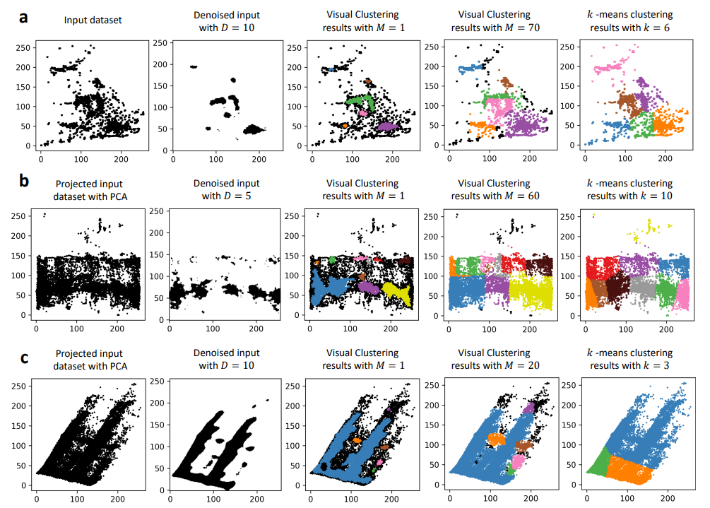

Slide 14
Algorithm | Number of Samples
 | 10K | 50K | 100K | 500K | 1M | 2M
Visual Clustering | 0.292 | 0.571 | 0.909 | 3.686 | 7.222 | 14.096
K-Means | 0.155 | 0.541 | 1.103 | 5.470 | 9.519 | 18.959
Gaussian Mixture | 0.089 | 0.358 | 0.726 | 3.047 | 5.949 | 11.962
DBSCAN | 0.093 | 0.357 | 0.837 | 7.604 | 20.009 | 52.648
Affinity Propagation | 175.35 | ∞ | ∞ | ∞ | ∞ | ∞
MeanShift | 3.482 | 101.82 | ∞ | ∞ | ∞ | ∞
Spectral Clustering | 0.052 | 0.509 | 0.796 | 7.455 | 20.001 | 53.559
Ward | 1.994 | 27.965 | 93.564 | ∞ | ∞ | ∞
Agglomerative Clustering | 1.177 | 12.154 | 39.886 | ∞ | ∞ | ∞
Optics | 16.515 | ∞ | ∞ | ∞ | ∞ | ∞
BIRCH | 1.298 | 7.390 | 14.320 | ∞ | ∞ | ∞

Slide 15
Thanks For Listening

